Slide 1
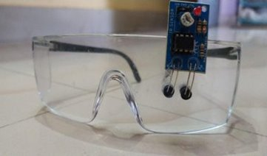
Smart Glasses for Drivers Mini Project (KEC-354)

Slide 2
Introduction
Smart glasses for drivers consist of two main parts , one is the glasses that have IR sensor attached to it ,which serves the purpose of detecting if the eyes of the wearer are closed and microcontroller , that takes the input from the sensor and rings the buzzer and stops the vehicle if driver’s eyes are closed.

Slide 3
Components used with specification
Arduino nano , a microcontroller having program uploaded in it so it can control the system.
Arduino Nano
Relay Module
Relay for switching purpose.
IR Sensor
IR Module to detect motion of eye.
Glasses ​
Any pair of transparent glasses of suitable design on which IR sensor is to be mounted.​​
​​

Slide 4
Continued...
Gear Motor
A gear motor for rotating the wheel.
Wheel
A wheel to demonstrate vehicle.
Piezo Buzzer
Buzzer for alarm.
Wires
Wires for connection between different components of device.

Slide 5
Project Details
⦁ Glasses have an IR sensor fixed on it.
⦁ When the sensor detects that the eyes of the driver are closed, it sends a signal to the microcontroller.
⦁ If it stays in that state for longer than a certain time period, it turns the alarm on.
⦁ If the driver opens his eyes on this, the device goes back to its initial state, i.e. alarm stops.
⦁ In case the person is yet not alerted the controller will send a signal to the vehicle and the vehicle would stop.

Slide 6
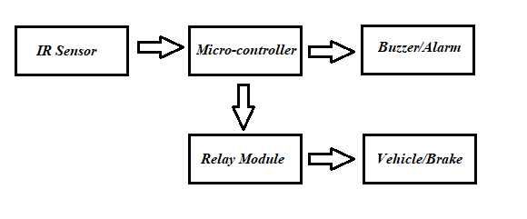
Pictorial Representation

Slide 7
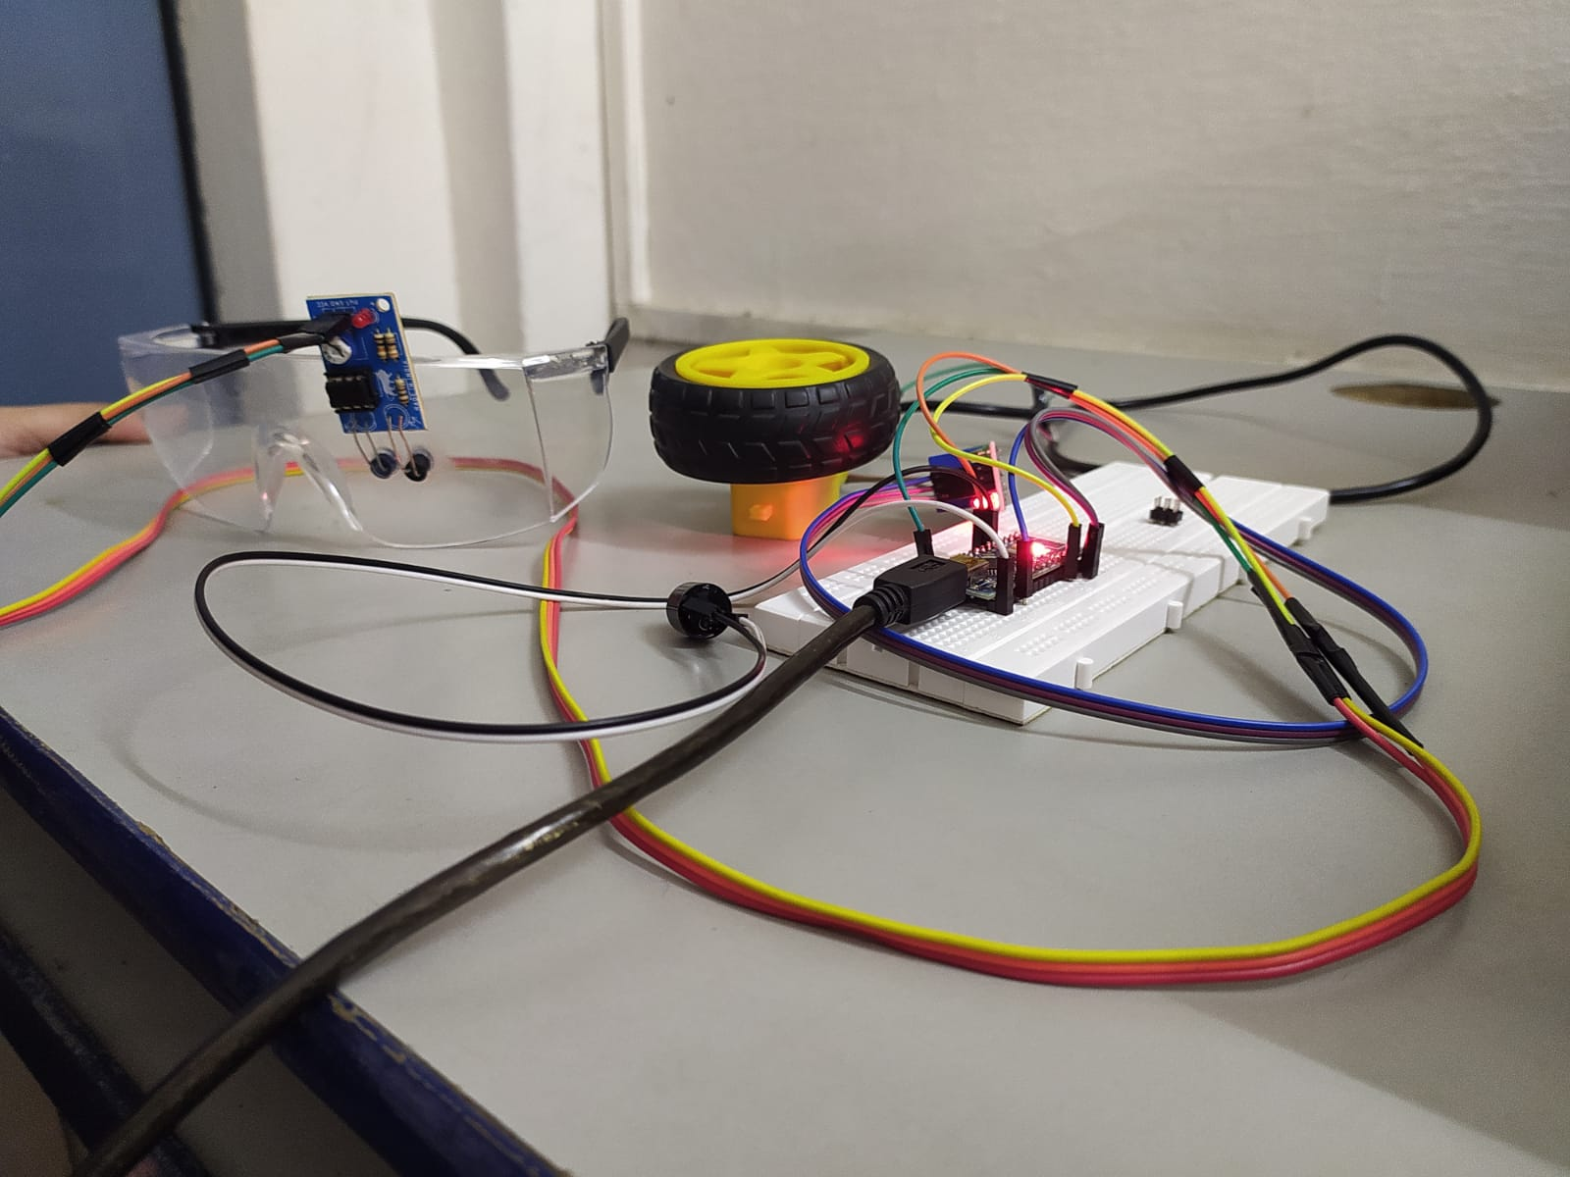
Prototype Testing

Slide 8
Conclusion
● The drowsiness detecting smart glasses proposed here in the minimum intrusive approach for dealing with driver drowsiness.
● It is based on IR sensing technology and micro controlling using an Arduino.
● The detection mechanism is unaffected by the ambient light present and can work irrespective of what time of the day it is .
●It is an effective way to detect drowsiness.

Slide 9
Future Scope
Other than the mentioned use case, this can be used in various other cases too with some manipulation in the design.
➢ For students :- Many students study late at night. This can help them to stay awake and concentrated at that time.
➢ For watchmen:- It is a very difficult job to stay awake for long hours and important for the purpose of safety at the same time where smart glasses find a vital role.
Notes:
Other

Slide 10
Thank You

